Slide 1
The Victorian Period
1830-1900

Slide 2
The Victorian Period
Certain times in history have names to represent the era
1830-1900 is know as the Victorian Period in Britain
Queen Victoria reigned during this time
1832-1901 –a very long reign

Slide 3
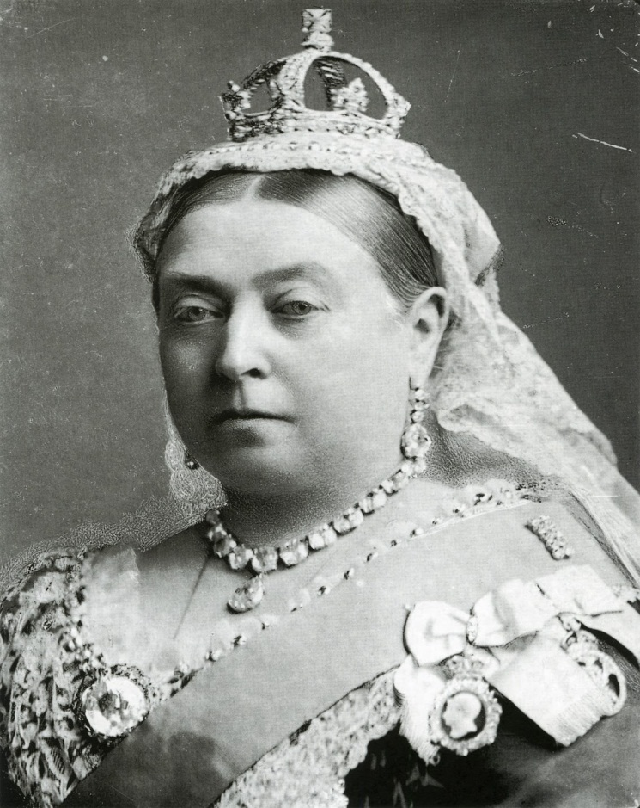
Queen Victoria

Slide 4
Changes
During the Victorian Period many great changes occurred
England became the wealthiest nation
The British Empire expanded rapidly
Industrial revolution
Political and social reform
Intellectual progress
BUT, not all changes were considered progress.

Slide 5
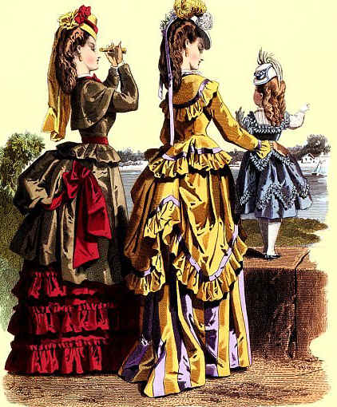
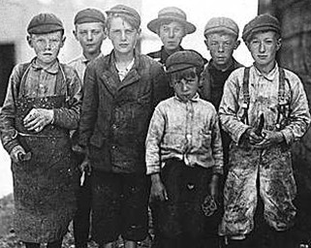
A time of contrasts

Slide 6
Words that characterize the time
Progress
Reform
Decorum and Etiquette
Doubt
Empire and Colonialism

Slide 7
Progress
The middle class saw history as a progress
Progress that was material improvement could be seen, touched, counted and measured
“The history of England is emphatically the history of progress” –Thomas Macaulay

Slide 8
Progress
Industrial Revolution
Created new towns, goods, wealth, jobs for people climbing through middle class – all tactile examples of progress
Social & economic changes expressed in gradual political reforms
Ie. Voting laws were changed to identify who could vote
Ie. Education laws were changed to identify who could go to school
Ie. Work laws were changed to identify who could/could not work; appropriate wages and hours, etc.

Slide 9
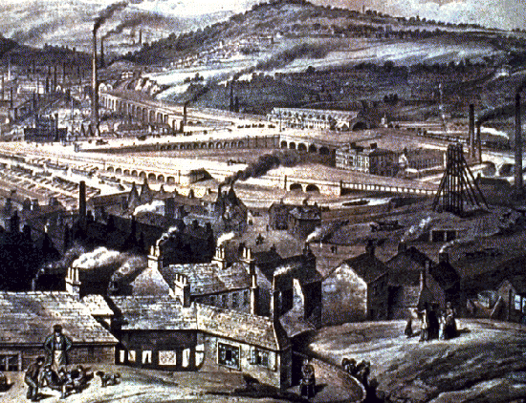
The Industrial Revolution

Slide 10
Progress
Much intellectual progress occurred at this time as well.
Many great thinkers made developments.
Charles Darwin
Adam Smith
Matthew Arnold
Etc.

Slide 11
Reform
Voting Reform
First Reform Bill in 1832 extended vote to all men who owned property worth 10 pounds
Second Reform Act in 1867 gave the right to vote to working-class men (except agricultural workers)
Women for suffrage – did not succeed until 1918 (30 & over)
Universal adult suffrage 1928 extended vote to women at age 21
Notes:
Most people believed the Victorian era was better than the past and that it would continue to improve. This was based on the fact that the material condition of people in all social classes had steadily improved.

Slide 12
Reform
Factory Acts – limited child & women labor
State supported schools est. in 1870
Literacy rate increased from 40% to 90% from 1840-1900.

Slide 13
Decorum and Etiquette
In addition to progressing materially, many Victorians saw themselves as progressing morally and intellectually.
Decorum: appropriateness of behaviour or conduct
Etiquette: conventional requirements as to social behavior

Slide 14
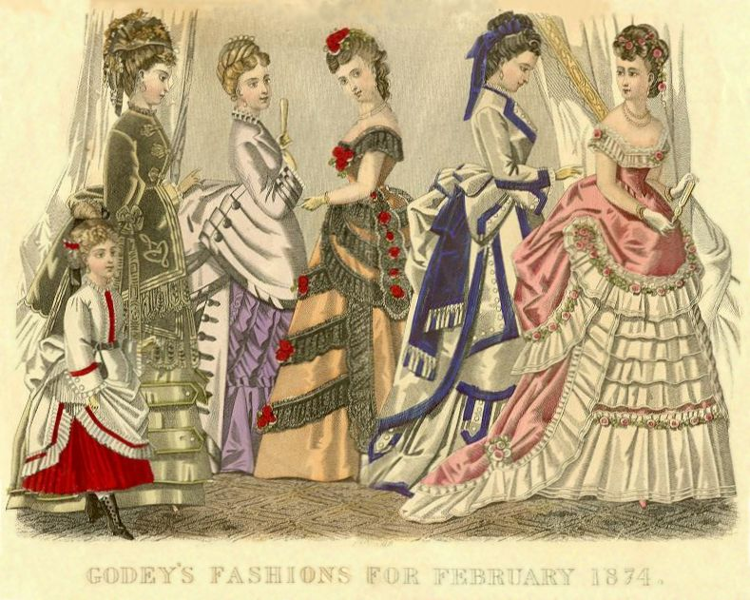
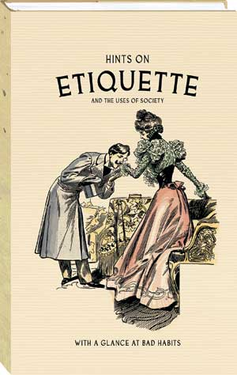
Decorum and Etiquette

Slide 15
Decorum and Etiquette
Victorian Decorum
The belief that life would be improved if it became more refined, rationally organized, better policed and safer.
Victorian Etiquette:
A set of rules for society that were to be strictly followed.
Ex. Women were expected to marry and take care of the home.

Slide 16
Decorum and Etiquette
Paradox of progress
Victorian – synonym for prude; extreme repression
Examples of Victorian repression
Furniture legs had to be concealed under heavy cloth not to be “suggestive”
Words were altered in books and magazines so as not to offend
Information about sexually transmitted diseases was eliminated
Censorship of writers: no mention of “sex, birth, or death”

Slide 17
Decorum and Etiquette
A woman’s role
Victorian private lives – autocratic father figure
Women – subject to male authority
Middle-class women expected to marry & make home a “refuge” for husband
Women had few occupations open to them
Unmarried women often portrayed in comedy by male writers

Slide 18
Doubt
Writers began to wonder if progress was really occurring.
Influenced by materialism, secularism, vulgarity, and sheer waste that accompanied Victorian progress.
Trust in transcendental power (God) gave way to uncertainty and spiritual doubt.

Slide 19
Empire and Colonialism
Empire: imperial or imperialistic sovereignty, domination, or control
Colonialism: the control of one nation by “transplanted” people of another nation — often a geographically distant nation that has a different culture and dominant racial or ethnic group.

Slide 20
Empire and Colonialism
Great Britain continued to expand its empire by acquiring colonies around the world.
“By the end of the nineteenth century, nearly one-quarter of the earth's land surface was part of the British Empire, and more than 400 million people were governed from Great Britain, however nominally.” –Norton Anthology

Slide 21
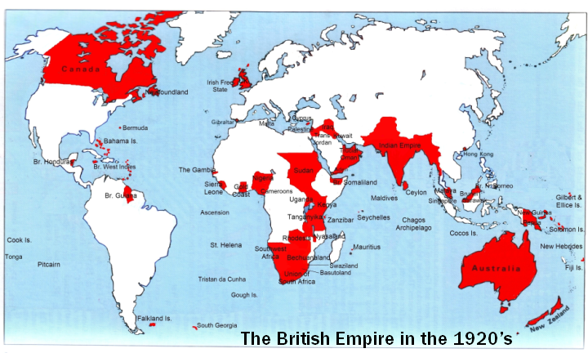
Empire and Colonialism

Slide 22
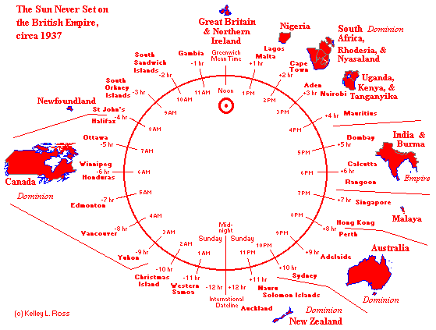
The sun never sets…

Slide 23
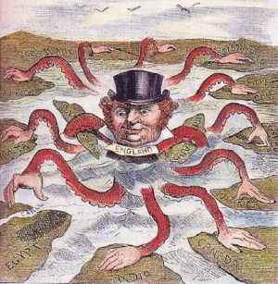
Empire and Colonialism
Cartoon of John Bull as an imperial octopus, 1888

Slide 24
In summary
The Victorian age was one of great changes, but also one of severe repression.
As a result, many writer’s turned to satire to criticize the time.

