Slide 1
The Northwest from 1800-1860

Slide 2
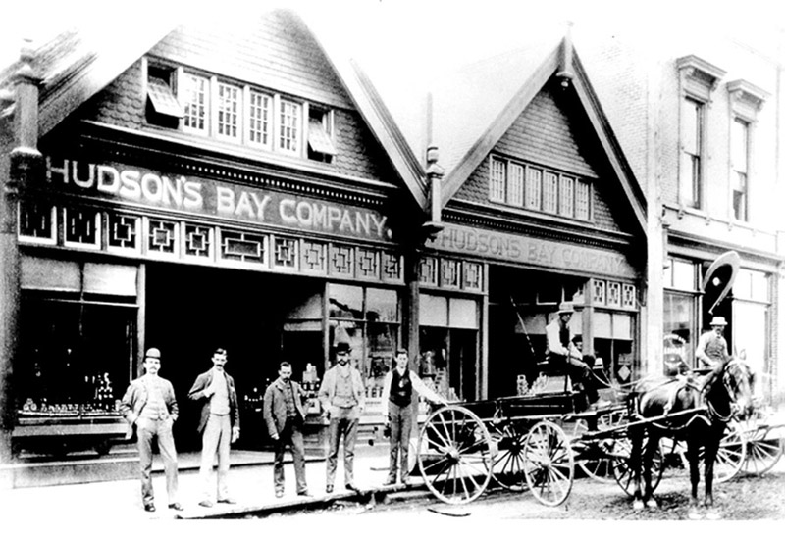
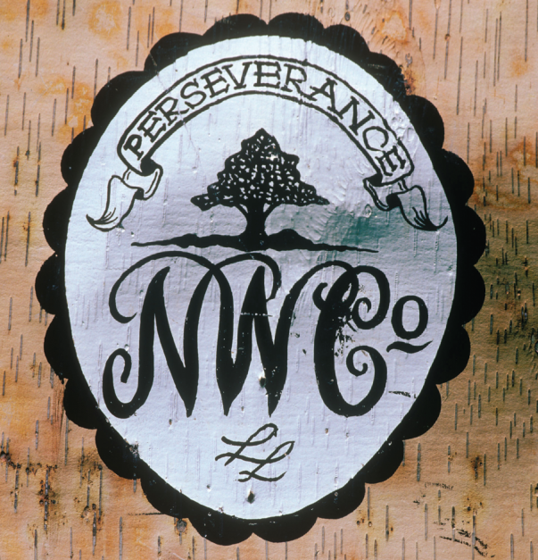
Review
Partner Talk
With a partner discuss what you remember from last class.
Be prepared to share with the class

Slide 3
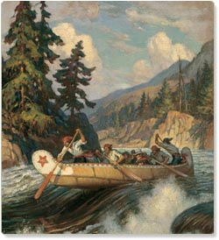
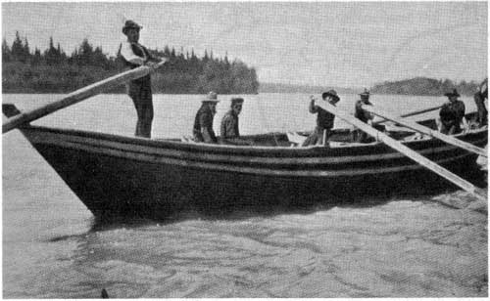
Key points to remember
The difference between the HBC and the NWC
The effects of the fur trade on the First Nations people

Slide 4
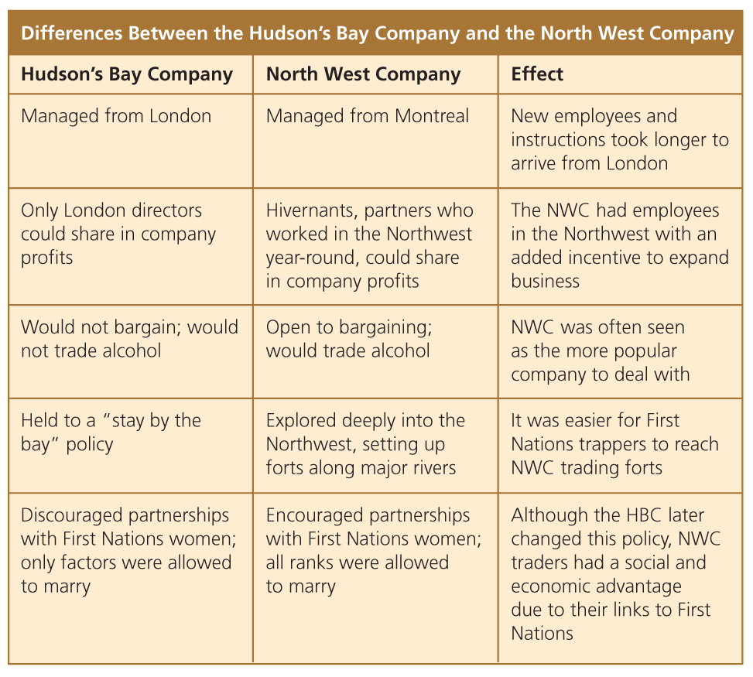
HBC vs. NWC

Slide 5
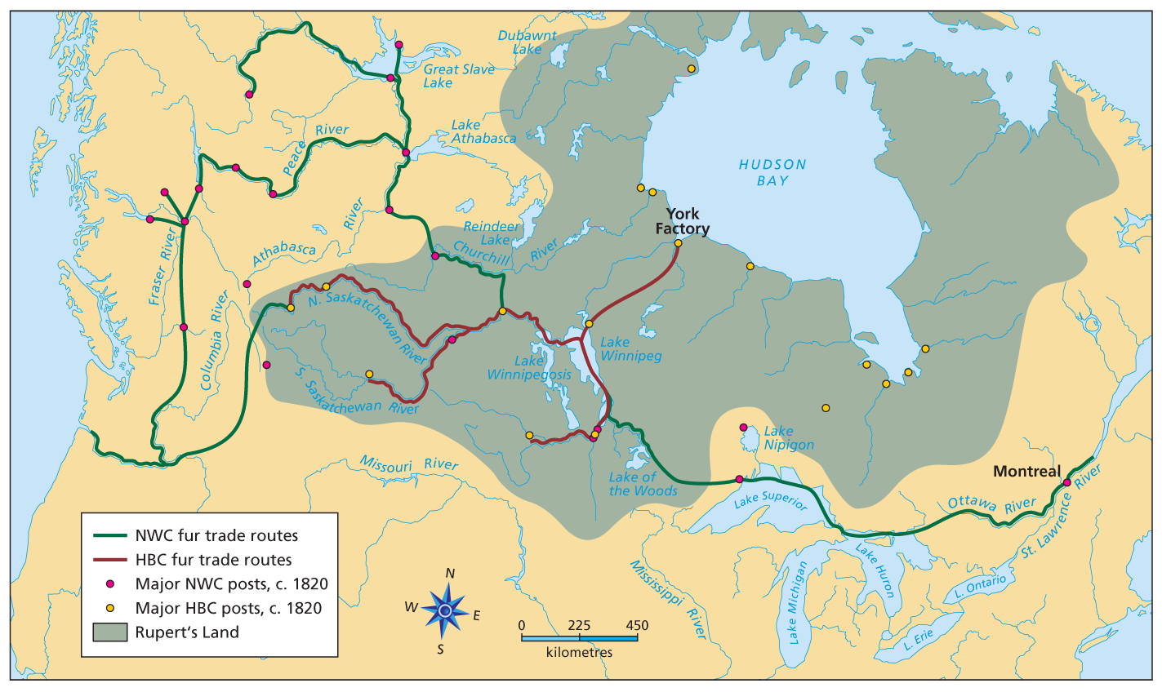

Slide 6
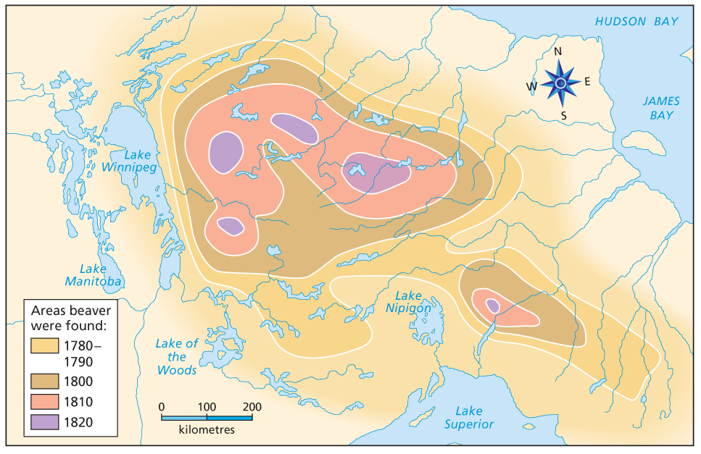
The Battle for the Fur Trade

Slide 7
The Battle for the fur trade
Competition between the HBC and the NWC was increasing because fur resources were declining.
Both companies had to change tactics to remain in business.

Slide 8
The Metis
Many men in the NWC married Native women
The NWC company thought these marriages would encourage loyalty.
Wives of fur traders enjoyed an improved standard of living and their lives were generally easier.
With many marriages a community of people developed.
Settled in Red River.
They called themselves the Metis.
People with French and Native ancestry.
Usually spoke French and Algonkian.
Were Roman Catholic.
Developed a lifestyle that combined both Native and European customs.

Slide 9
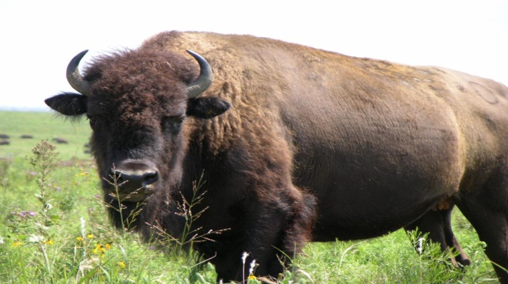
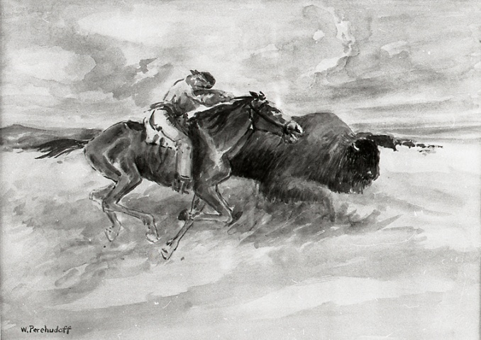
Metis customs
The Metis both farmed and hunted to survive.
The Metis used a seignurial pattern to organize their farms.
A long lot pattern.
This would later cause problems with land surveyors.
The Bison hunt was an important event that occurred twice a year.
It was considered the most important social event for the Metis.

Slide 10
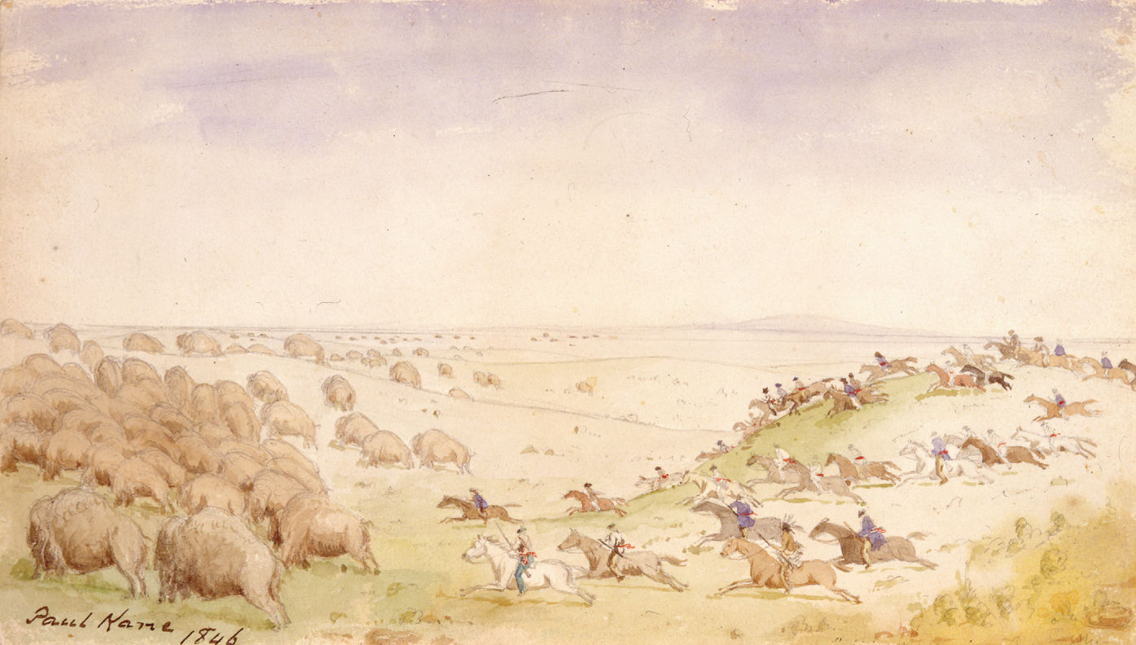
The Bison Hunt
Took place in the early summer and autumn.
Provided fresh bison hides, as well as meat and fat that were required to make pemmican.
Metis women, men and children would set out across the Prairies in Red River Carts, travelling many days in the search of the right herd.
The hunt brought together the entire Metis community.

Slide 11
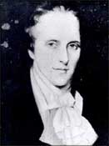
The Red River Colony
Thomas Douglas (Lord Selkirk) decided that he wanted to establish a colony in Red River.
He wanted to help the poor tenant farmers in Scotland.
Tenant farmers do not own their land
They work on someone else’s land and are a tenant.
In Scotland they were being kicked off their land and had no where to go.
Selkirk (also a director of the HBC) also hoped that food produced by the farmers in Red River could be used to feed HBC employees.

Slide 12
Problems in Red River
The HBC gave Lord Selkirk 300 000 km of land in Rupert’s land.
Called “Selkirk’s grant”
But they did not think about the people who were already there.
The Metis
The Scottish farmers were unprepared for the harsh weather conditions.
Pemmican Proclamation
Issued to protect the Selkirk colonists’ food supply.
Forbade the sale or export of pemmican from Red River.
The Metis relied on the proceeds of selling pemmican to the NWC and were very angry.

Slide 13
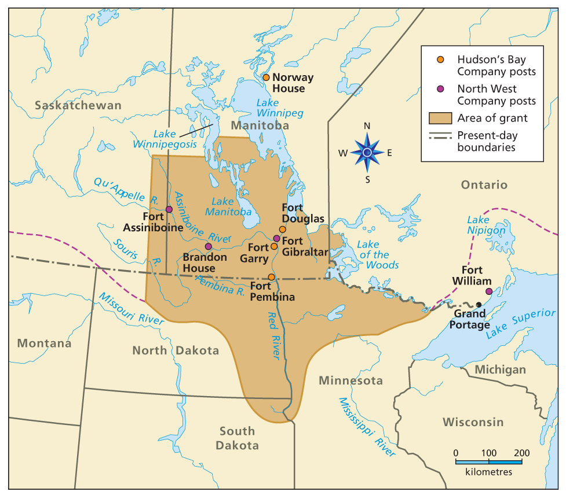

Slide 14
Problems in Red River
There was constant disagreement between the Metis/NWC and the colonists of Red River.
Key leaders in Red River were to blame
Miles Macdonell
Robert Semple
Each group harassed the other in various ways.
Burning buildings
Trampling crops
The tension created resulted in an armed conflict between the groups.
The Metis felt they had more claim to the land then the settlers.
The settlers felt the Metis were inferior because of their mixed ancestry.

Slide 15
The Battle of seven oaks
The Metis fired the first gun shot.
They were skilled sharpshooters and outnumbered Semple and his men 3:1.
Resulted in the death of 21 colonists and 1 Metis.
This battle turned the dispute between the HBC , NWC and Metis into a full-fledged conflict.
This battle increased social tensions in the Red River Settlement.

Slide 16
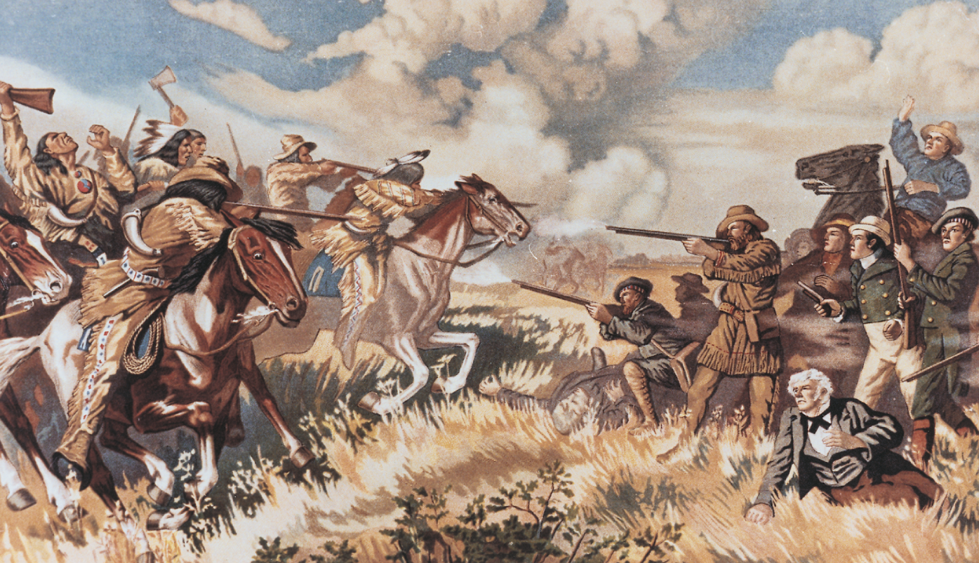
Battle of seven oaks

Slide 17
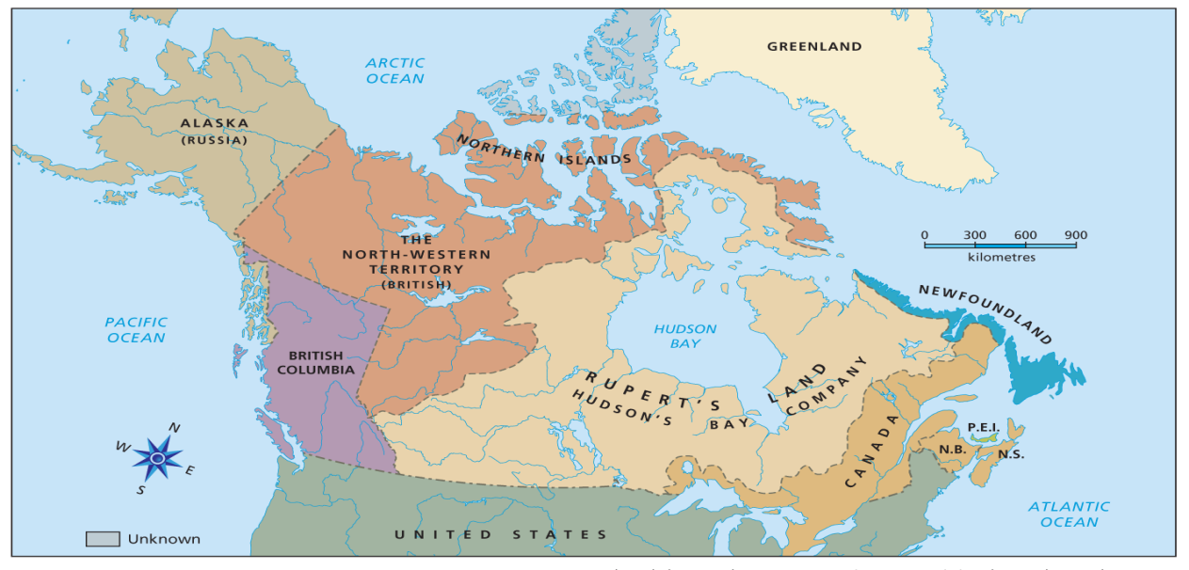
The Merger
In 1821 the HBC and NWC joined together.
The new company took the name The Hudson’s Bay Company.
The company was given control over Rupert’s Land.

Slide 19
Predictions
Can you predict any problems that might be caused by the selling of Rupert’s Land?

