Slide 1
Short Story Terms:
Point of View
&
Inferences
Short Story Terms

Slide 2
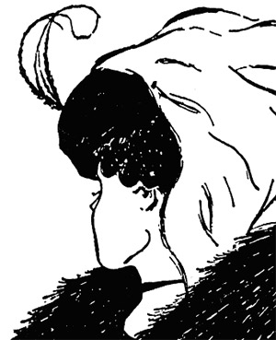
5 possible POV’s:
First Person
Second Person
Omniscient
Limited Omniscient
Objective
PERSPECTIVE:
Do you see an old woman or a young woman?

Slide 3
1) First Person:
written from the
perspective of one
character in
particular.
I remember standing in that small, dimly lit room. There was no air circulation. Each breath I took felt like a mass of congealed soup slipping into my lungs. The ripe smell in the air lingered around; silently mocking and tormenting me with its invisible tendrils of death and decay. My mind forced me to look away, yet my eyes kept gravitating back with an impossible will of their own.

Slide 4
You sit with your legs straight in front of you; they have come out from their winter stockings and are very thin and knobbly, but the sun is beginning to warm them gently as if it were glad to see them again.
Your back is against Mother's chair and occasionally she puts her finger between your collar and your skin, to feel if you are warm; you are warm and you pick up your knitting because you can knit; with your finger you follow the wool along the big wooden pins and you say, "Knit one-knit another"; with the slow puffs of wind. The wind brings the garden scents and the sounds to you; sounds of birds and neighbors and the street.
From “You Need To Go Upstairs” written by Rumer Godden
2) Second Person:
The narrator tells the story to another character using “you”

Slide 5
3) Omniscient:
written in 3rd
person and gives us
the thoughts,
feelings, and
motivation of all of
the characters.
John stood next to his grandmother. He wanted to help her down the stairs. Mrs. Smith looked at her grandson, her blue eyes sharp, and moved a strand of hair from her face. She was determined to do this on her own, to prove she wasn't a helpless old lady . . .

Slide 6
4) Limited Omniscient:
written in 3rd
person but only
gives us the
thoughts of one
character.
John laughed hollowly. “You’re joking,” he said, wondering how on earth he would ever get over this. Veronica shook her head slowly. He tried desperately to read her face for an explanation. John stood up and banged his fist against the wall, hard, once, but that did nothing to disperse the fury coursing through him. He still couldn’t believe it. “I’ll have to leave now,” he said, thinking that he couldn’t bear to stay there another moment. Veronica nodded slowly. He was upset now, but he knew she'd get over it.

Slide 7
5) Objective:
written so that the
author does not
reveal any
characters’ thoughts
or feelings.
(Instead, they are
inferred through
actions, dialogue,
etc.)
John laughed hollowly. “You’re joking,” he said. The neon light flickered on his face, turning it a ghastly yellow. Veronica shook her head slowly. Her fingers were busy shredding her tear-stained paper tissue. “I’m not joking. It’s all true.” John stood up and banged his fist against the wall, hard, once. He was shaking his head in disbelief. “I’ll have to leave now,” he said, his voice tense.

Slide 8
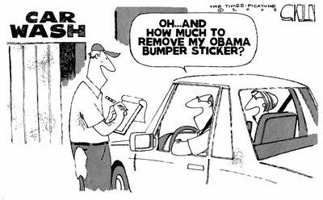
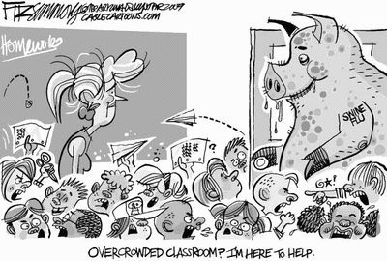
Definition for “Inference”:
The act or process of deriving logical conclusions from premises known or assumed to be true.
b. The act of reasoning from factual knowledge or evidence.
The American Heritage Dictionary

Slide 9
PRACTICE MAKING INFERENCES!
The room was a mess! Pots and pans were piled in the sink. Drawers and cabinets were flung open. Chocolate chips dotted the floor and empty cartons were on a sticky counter, but the smell was delicious.
Why was the room a mess?
The young woman looked down at her long dress. She felt like a princess. She and the others stood in the hall. They listened to the music. Then she heard the cue. She walked down the aisle as she held her flowers.
What was this event?
The girl saved all her money. It was exactly what she wanted. She imagined gliding down the road pedaling effortlessly. She finally had enough money to make her dream come true.
What was her dream?

Slide 10
The bear ate lots of nuts and fish. Her fur got thick. She prepared her den. The leaves fell from the trees and the days turned colder.
What was the bear getting ready to do?
Mailboxes are lined up outside the door. There is a long counter inside with scales. You can buy stamps, envelopes, and boxes. There are slots where you can mail a letter and long rows of boxes where some people go to pick up their mail.
What is this place?
The cat stretches and yawns. She strolls over to her favourite spot. The sun shines in and makes it very warm. She watches the birds and squirrels. Sometimes the fresh air blows in on her. She climbs up into her soft bed and looks at the animals for a while. Then she curls up and goes to sleep.
Where is the cat’s favourite spot?

