Slide 1
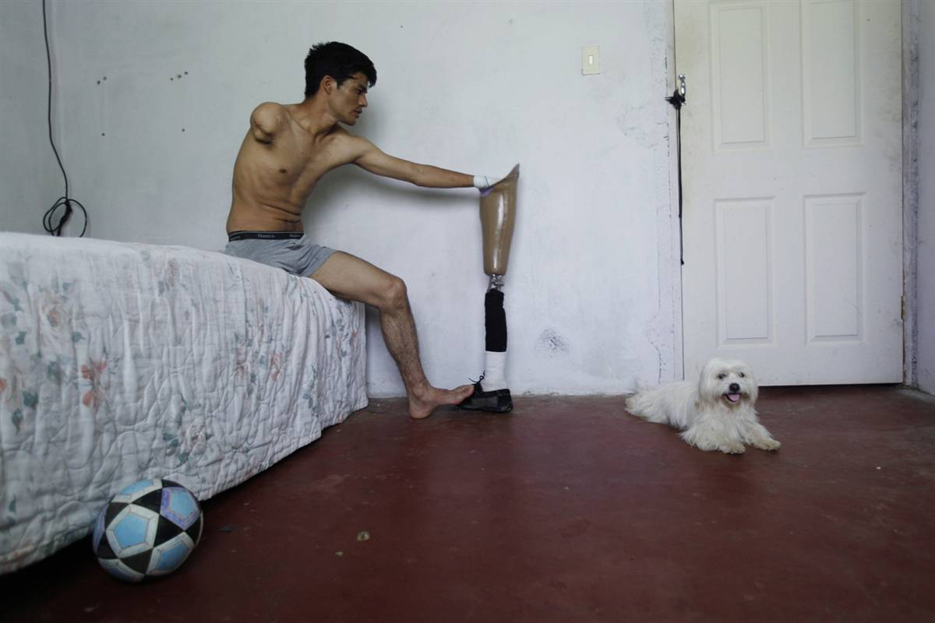

Slide 2
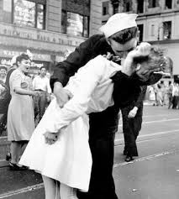

Slide 3
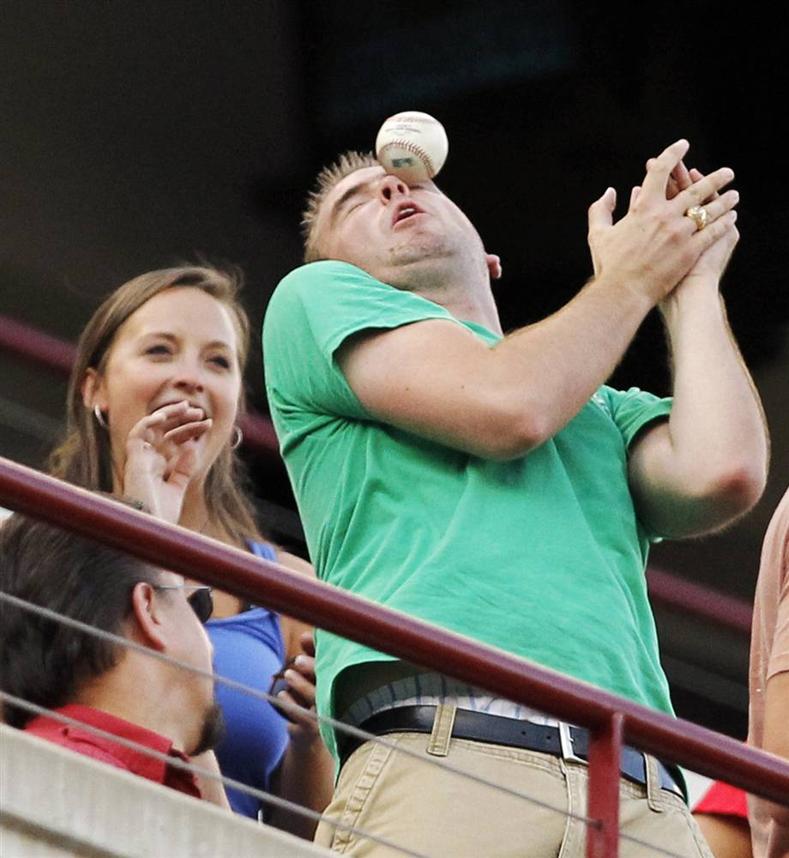

Slide 4
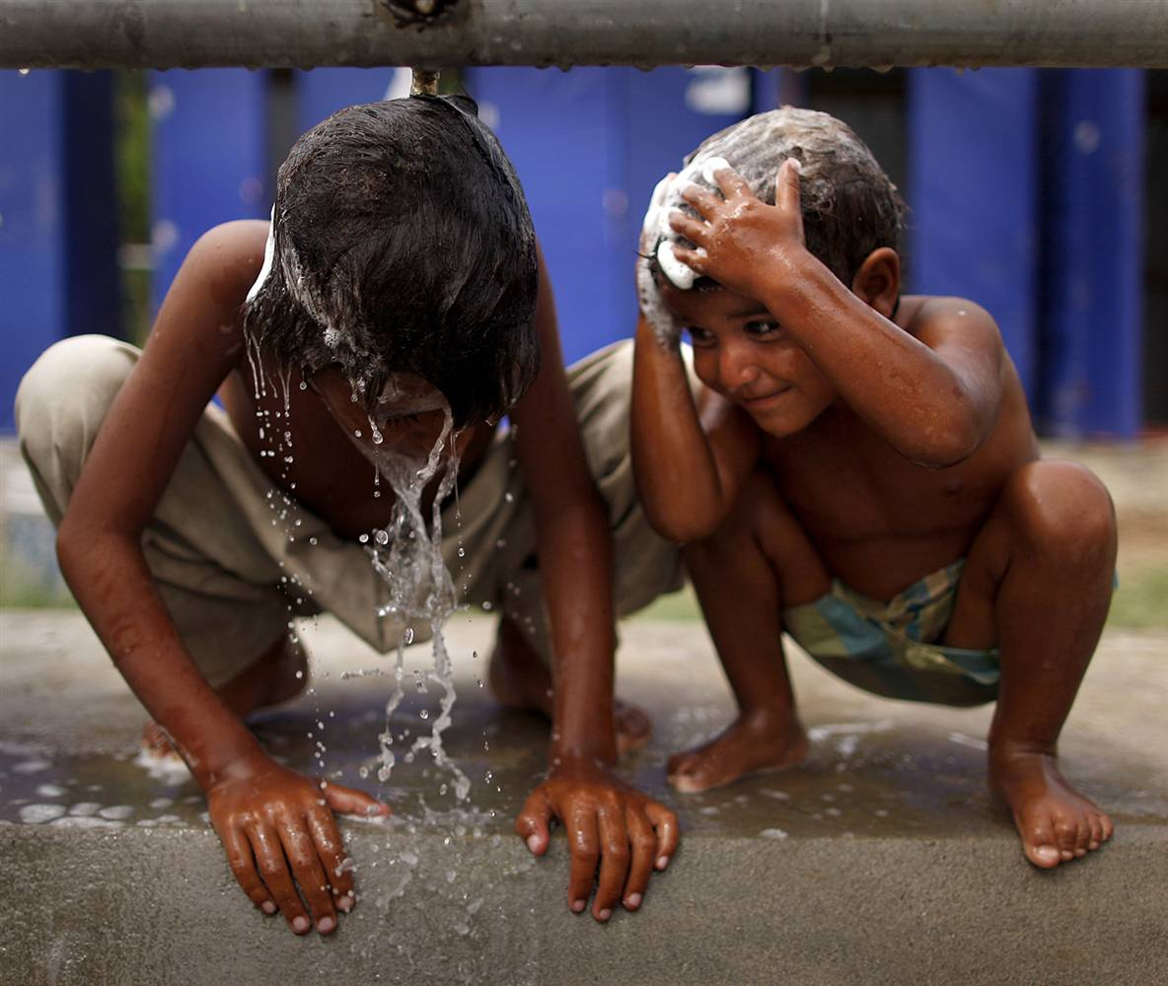

Slide 5
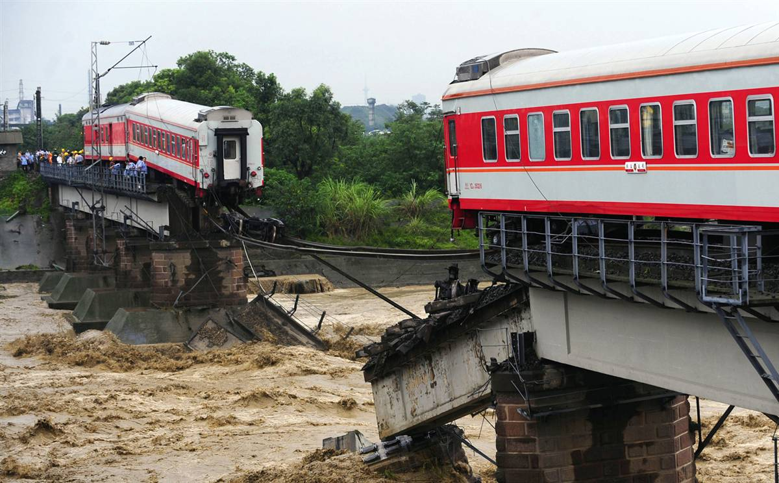

Slide 6
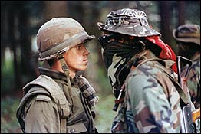

Slide 7
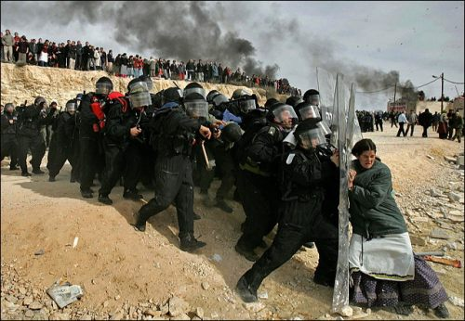

Slide 8
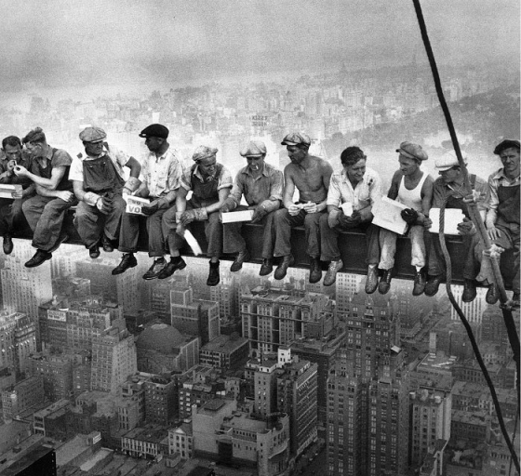

Slide 9
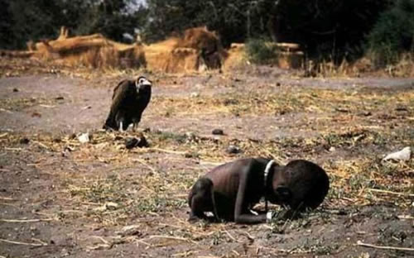

Slide 10
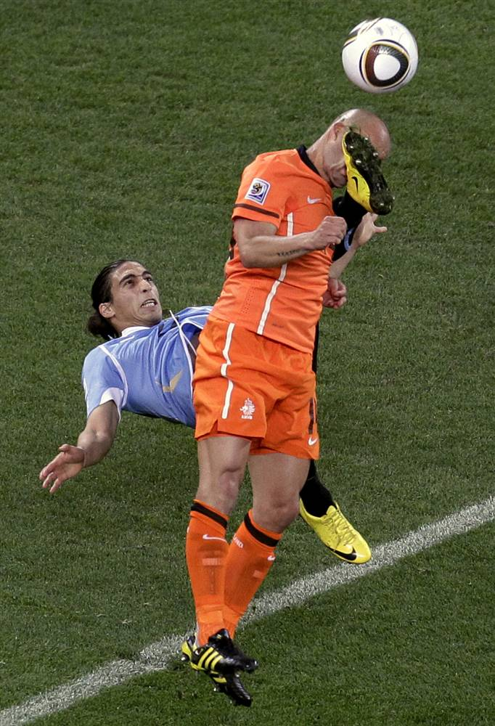

Slide 11
It’s not every day that Soccer superstar John Sanderson was kicked in the face with the same velocity and fury of a raging bull mutilating a runner in Pamplona. However, his day didn’t start any better. The kick in the face would serve as a metaphor and physical reminder of the day his wife left him. She’d taken his Porshe, his Mastercard and she pulled the sleek car out of his driveway and out of his life forever. Forever. The words sunk in. “Forever” wafted from his tongue like a light misty fog and then disappeared into the dusty traffic whirling down the street near his palatial manner house. “What worse could happen,” he mused, laughing more to slap a band aid on his wounded ego than anything. Besides, the big game against Brazil was today; if he scored one goal he’d break the all-time record. Nothing could ruin his adrenaline high. Nothing. He stopped short of saying it out loud, realizing he didn’t want to have to put his foot in his mouth later if the day got any worse. Interestingly, fate had already decided 29 years earlier that his jaws would feast upon a foot, albeit not his own.

