Slide 1
Integrity
Definitions

Slide 2
Integrity Synthesis
You will write an in-class synthesis essay between The Crucible and your class novel.
You will be asked to compare and/or contrast two different characters based on their integrity. Essentially, demonstrate the quality of integrity shown by the characters.
Consider: Do they show integrity? Or, do they not show integrity?

Slide 3
Integrity
Definition:
Adherence to moral and ethical principles
Soundness of moral character
Honesty

Slide 4
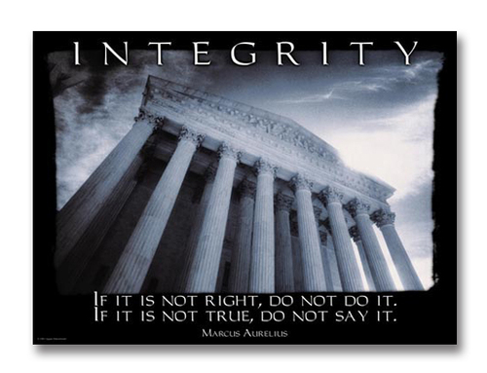

Slide 8
How to evaluate integrity?
Many possible options
You must decide what you want to focus on

Slide 9
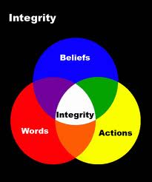

Slide 10
Questions?

