Slide 1
History vs. the Past

Slide 2
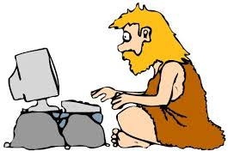
History vs. the past
What is the difference between history and the past?
Discuss with a partner

Slide 3
The past
Things that happened before today.
Yesterday is in the past.
For example, a few classes ago we learned about the physical regions of Canada– that is now the past.

Slide 4
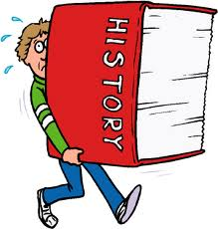
History
Events or people from the past that have some significance.
History is a story about the past.
Historians construct the story by using evidence from the past.

Slide 5
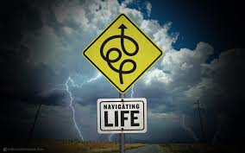
Diagram of your life – 10 min
Create a diagram of your life
Include your most significant events
Use symbols, words, pictures
Arrange any way you like

Slide 6
Diagram of your life
Share your diagram with your partner

Slide 7
Diagram of your life
How did you decide what to include in your diagram?
What criteria did you use?

Slide 8
Historical Significance – Be a historian
How do we decide what is important about the past?
Discuss with a partner
Share out with the class

Slide 9
Historical Significance
An event, person or development has historical significance if it resulted in change
impacted many people
impacted them deeply
over a long period of time

Slide 10
Practice # 1
Canada vs. USA Women’s Gold Medal Hockey Game
2014
Canada won in overtime
The United States was leading for the majority of the game
Became Team Canada’s 4 Consecutive Gold Medal

Slide 12
Historically significant?
An event, person or development has historical significance if it resulted in change
impacted many people
impacted them deeply
over a long period of time

Slide 13
Practice # 2
World Trade Center Attack
Sept 11, 2001
Planes were flown into the World Trade Center
Many people were killed and died from injuries
Many rescue works also died trying to help
Because of the attack, laws were changed in the US for dealing with terrorists
Many people who survived the attack have health problems related to the attack.

Slide 14
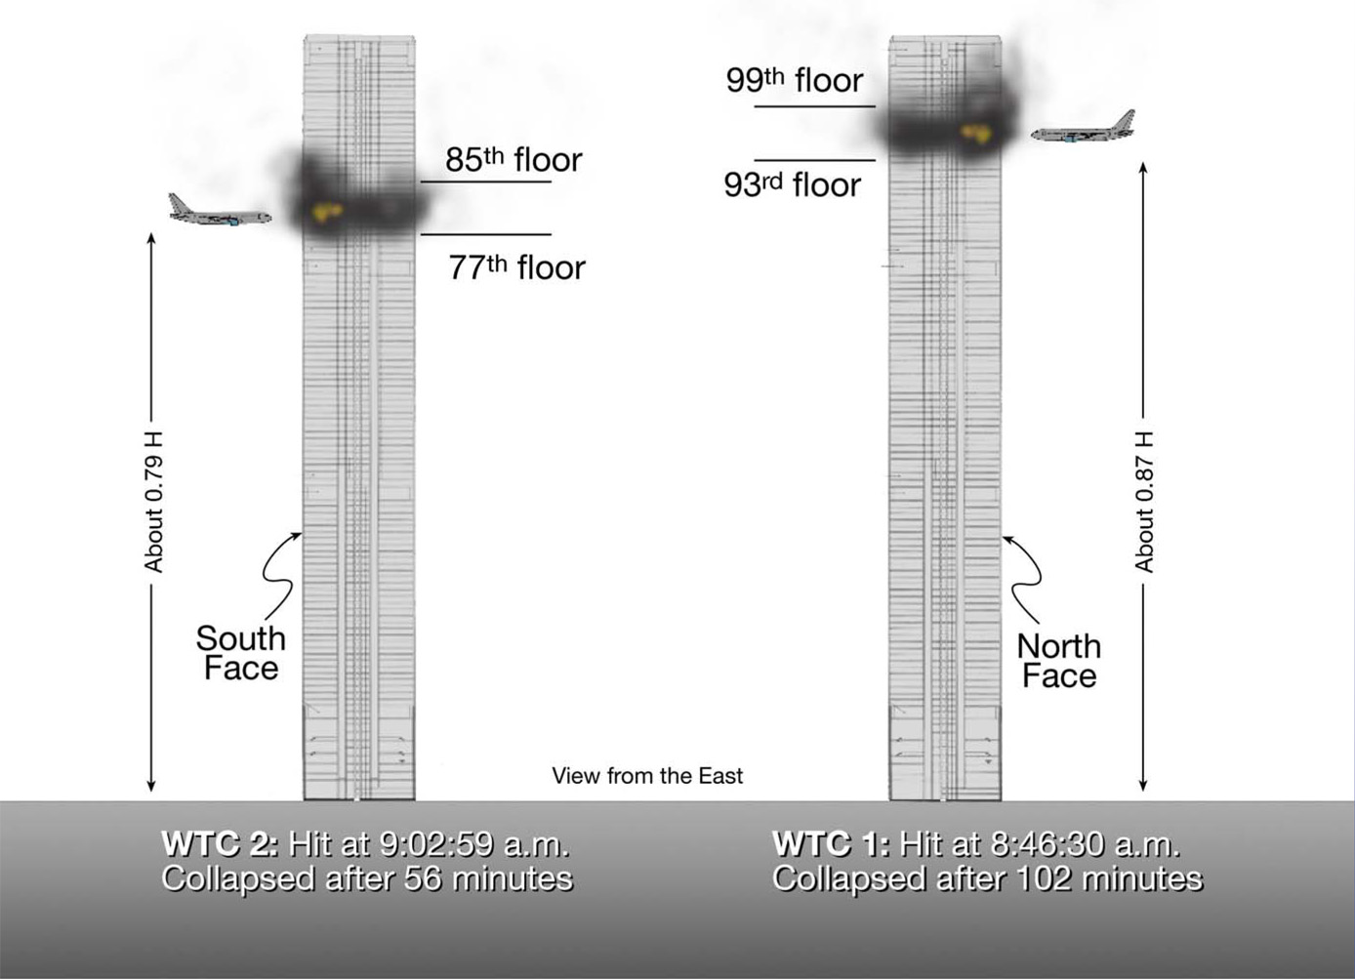

Slide 15
Historically Significant?
An event, person or development has historical significance if it resulted in change
impacted many people
impacted them deeply
over a long period of time

Slide 16
Brainstorm – Practice
In a group of 4, brainstorm events or people you think are historically significant.
Use the criteria for judgment to decide if they are historically significant.
Share out with the class

