Slide 1
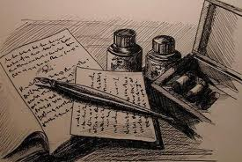
A Formal Literary Paragraph

Slide 2
What is a formal literary paragraph?
A FLP is an analytical paragraph that makes and supports an argument.
You will be given a topic to discuss.
Your task is to create an idea based on the topic and to find relevant and supporting examples in the text to support your idea.

Slide 3
The FLP is the starting point
A FLP is written using similar techniques to an essay.
By practicing writing the FLP, you will also be establishing necessary essay writing skills.

Slide 4
Step 1 – The Hook
Write a catchy first sentence to interest your reader.
Make sure you connect it to your topic sentence.
Remember, there are lots of different ways to start your paragraph.

Slide 5
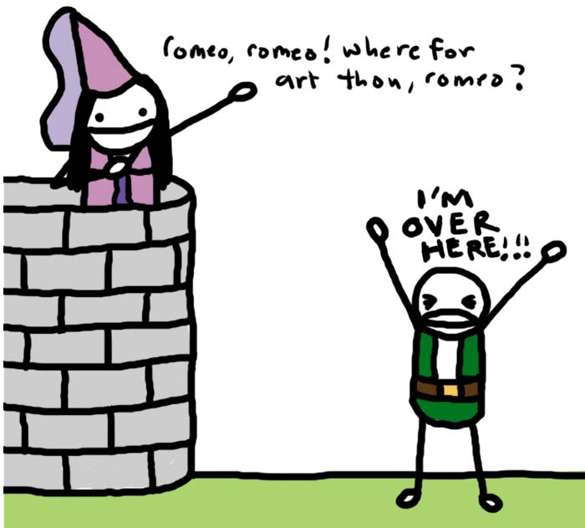
Step 2 – Topic Sentence
Your topic sentence must inform your reader of three things:
The author(s)
The title (s)
Your main idea

Slide 6
Examples
In John Boyne’s The Boy in the Striped Pajamas the character of Bruno is very innocent, but also deeply ignorant.
Author
Title
Main Idea

Slide 7
Examples
In William Shakespeare’s Romeo and Juliet, the characters of the Nurse and Lady Capulet both have a maternal relationship with Juliet.
Author
Title
Main Idea

Slide 8
Important Note
When referring to titles of books, plays, poems, and articles there are rules you must follow:
1) Underline or italicize titles of novels and plays
The Boy in the Striped Pajamas or The Cage
2) Use quotation marks for poems, short stories, and articles
“Ruthless”

Slide 9
Step 3– Make your 3 points
You want to include a minimum of three points in your paragraph.
The best way to present your points is to use the ACE structure.
You will need to use the ACE structure three times.

Slide 10
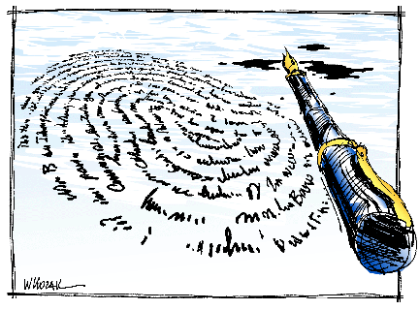
ACE Your Writing
Assertion (your point)
Citation (a quote or paraphrase)
Explanation (explains how your citation supports your assertion)

Slide 11
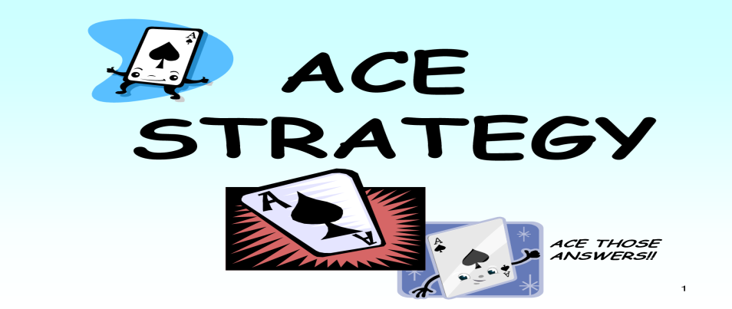
Example
Assertion: Bruno is very innocent and does not really understand what is happening.
Citation: When Boyne has Bruno say “Heil Hitler”, Bruno thinks it is another way of saying goodbye (Boyne, p. 54).
Explanation: This shows how much Bruno misunderstands the situation.

Slide 12
The Quote Sandwich
Don’t forget the quote sandwich.
Remember that you always need to introduce your quote.
When Boyne has Bruno say “Heil Hitler” (Boyne, p. 54), Bruno thinks it is another way of saying goodbye.

Slide 13
Step 4 – A thoughtful conclusion
A strong concluding statement is extremely important.
You want to restate your main idea in a new and thought provoking way!

Slide 14
FLP Structure
Hook
Topic Sentence
ACE # 1
Transition
ACE #2
Transition
ACE # 3
Concluding Sentence

Slide 15
FLP Example
In John Boyne’s The Boy in the Striped Pajamas the character of Bruno is very innocent, but also deeply ignorant. Bruno does not understand what is happening around him. For example, when Bruno says “Heil Hitler”, he believes that he is simply saying goodbye (Boyne, p. 54). This demonstrates how little Bruno understands and how naive he is. In addition, Bruno is jealous of Schmuel because he believes that life on the other side of the fence is better. He states, “That’s not fair at all. There’s no one to play with on this side of the fence. Not a single person “(Boyne, p. 131). This statement further confirms Bruno’s misinterpretation of life in the concentration camp. It is not until Bruno ventures onto the other side of the fence that he realizes his assumption is wrong. However, even though Bruno’s age and innocence can account for some of his misunderstanding, Bruno ignores many key signs that things are not as they should be. For instance, Schmuel is underweight and always hungry, but Bruno does not really acknowledge this. In fact, he even eats some food that he means to bring to Schmuel (Boyne, p 138). Additionally, Schmuel provides Bruno with many anecdotes of horrible events which Bruno ignores. In particular, Schmuel describes the treatment by the soldiers on the other side of the fence. He explains how horrible the conditions are and expresses his intense hatred of the soldiers, but Bruno always thinks about himself (Boyne, p. 195). This shows how focused Bruno is on his own life and not on the conditions in the concentration camp. In conclusion, although Bruno’s age and innocence can excuse a certain amount of ignorance, ultimately Bruno chooses to think about himself and not about what is happening on the other side of the fence.

Slide 16
6+ 1 Traits of Writing
The 6 + 1Traits
Ideas
Organization
Voice
Word Choice
Sentence Fluency
Conventions
Presentation

Slide 17
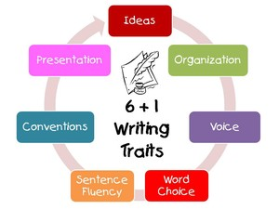
6 + 1Traits of Writing
Is a model used to evaluate writing.
Each trait looks at a different skill.

Slide 18
Formal Writing Rules
Avoid summarizing. You should assume your reader is very familiar with the text.
Always use the present tense.
Ex. Romeo was in love with Juliet.
This means Romeo is no longer in love with Juliet.
Ex. Romeo is in love with Juliet.

Slide 19
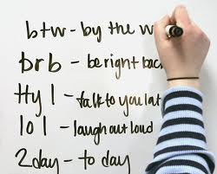
Formal Writing Rules
Use formal language.
No contractions
Don’t, can’t, doesn’t
Use the third person.
Do not use “I think..”
Avoid colloquial language
“Like, Juliet, is like, so, totally cool.”

Slide 20
Formal Writing Rules
Use transition words to connect your ideas

Slide 21
Transition Words/Phrases
Example #1:
To be honest, you must tell the truth. If you cheat on a test, that’s being dishonest. It’s better to receive the mark you deserve and learn from your mistakes. Tell the truth; it’s worth it!
Example #2:
In order to be honest, you must tell the truth. For example, if you cheat on a test, that’s being dishonest. Therefore, it’s better to receive the mark you deserve and learn from your mistakes. Tell the truth; it’s worth it!

Slide 22
Practice
Look at the example FLP and underline all the transition words used.

Slide 23
Your Turn
Time to write your FLP!

