Slide 1
Design Principles

Slide 2
C.R.A.P
Contrast
Repetition
Alignment
Proximity

Slide 3
Contrast
Contrast is created when two elements are different.
The key is--if two items are different--make them really different.
Examples of contrast
Font style or size
Colour

Slide 4
Contrast
Our eyes like contrast – when there is contrast on a page, we are drawn to it.
Purpose:
To create interest on the page
To help organize the page.

Slide 5
Contrast

Slide 6
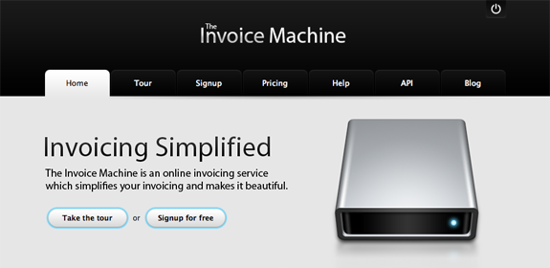

Slide 7
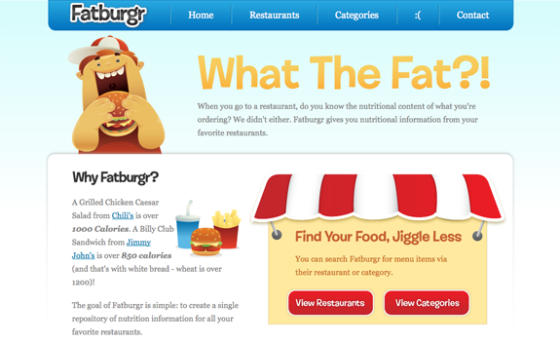

Slide 8
Repetition
You should repeat some aspects of the design throughout the entire piece.
Ex. A bold font, a symbol, a bullet type, a colour
It can be anything that the reader will recognize spatially.
Repetition can also be thought of as consistency.

Slide 9
Repetition
Purpose:
To unify and add visual interest.
The repetition of visual elements throughout the design unifies and strengthens a piece by tying together the document(s).

Slide 10
Repetition
What to avoid:
Avoid repeating an element so much that is becomes annoying or overwhelming.

Slide 11
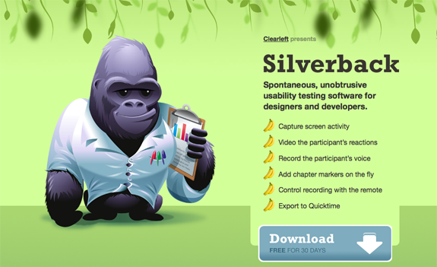

Slide 12
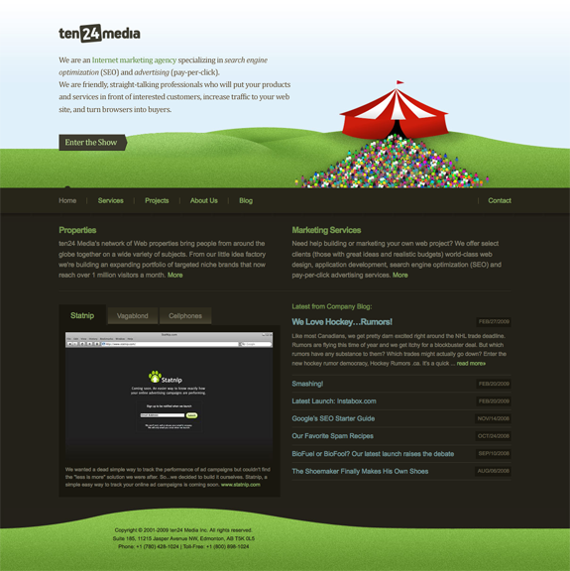

Slide 13
Alignment
Nothing should be placed on the page arbitrarily.
Every item should have a visual connection with something else on the page.
When items are aligned on a page, even if physically separate, there is an invisible line that connects them.

Slide 14
Alignment
To make all elements on a page appear unified and connected there needs to be some visual tie between the elements.
Alignment Options
Right justified
Left justified
Centered
Justify (aligned along both sides)

Slide 15
Alignment
What to avoid:
Center alignment – it is considered stuffy and safe

Slide 16
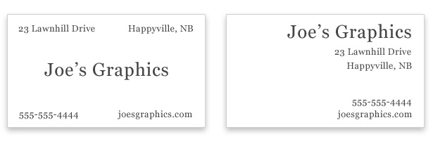
Example

Slide 17
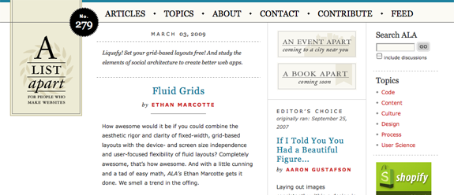
Example

Slide 18
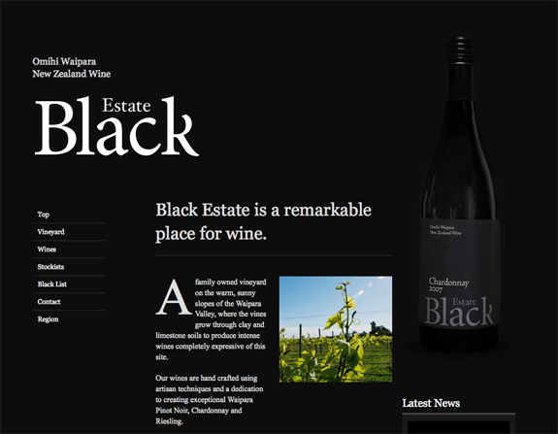
Example

Slide 19
Proximity
Items related to each other should be grouped close together.
This allows the items to become one visual unit.
It makes it easier to understand and follow.

Slide 20
Proximity
Purpose:
The basic purpose of proximity is to organize.
A more organized document is easier to read.

Slide 21
Proximity
What to avoid:
Too many separate elements on page.
Items in corners and in the middle.
Avoid equal amounts of white space between elements.
Don’t create relationships between elements that don’t belong together.

Slide 22
Example

Slide 23
Example

Slide 24
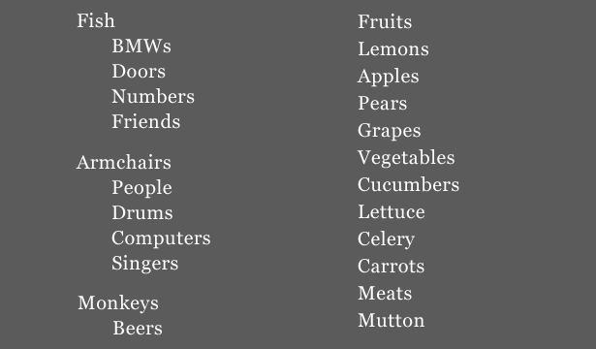
Example

Slide 26
Works Cited
Image taken from:
http://www.webdesignerdepot.com/2010/01/the-principle-of-proximity-in-web-design/
https://paper-leaf.com/blog/2012/10/principles-of-design-quick-reference-poster/
https://vwo.com/blog/crap-design-principles/

