Slide 1
Character
English 9

Slide 2
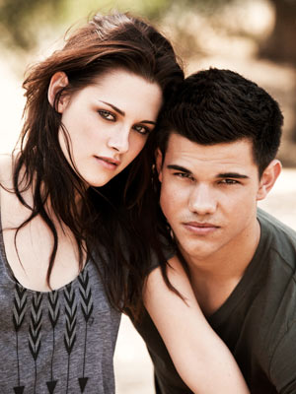
Character
A fictional person in a story, and the moral, dispositional, and behavioural qualities of that fictional person.

Slide 3
Five Types of Character
Flat Character
Round Character
Dynamic Character
Static Character
Stock Character

Slide 4
Round Character
A realistic character with several dimensions.
These characters are often complex and are fully developed.

Slide 5
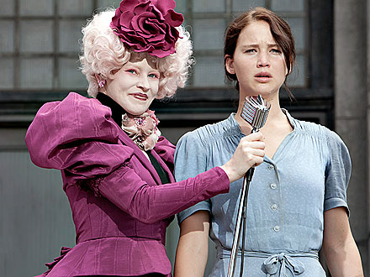
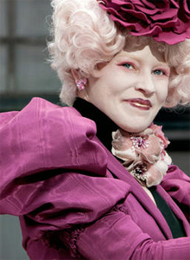
Flat Character
A character who is not fully developed by an author.
A character who has only one outstanding trait or feature, or at the most few distinguishing marks.

Slide 6
Flat or Round? Which is which?

Slide 7
Flat or Round? Which is Which?

Slide 8
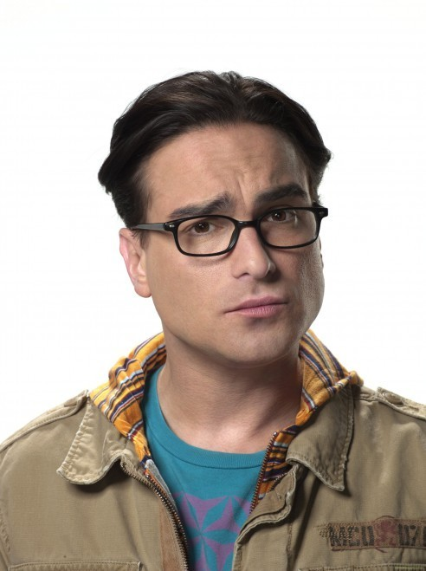
Dynamic Character
One who changes significantly during the course of the story.

Slide 9
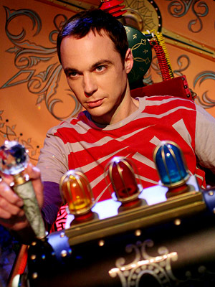
Static Character
A character who is the same sort of person at the end of a story as s/he was at the beginning.

Slide 10
Dynamic or Static? Which is which?

Slide 11
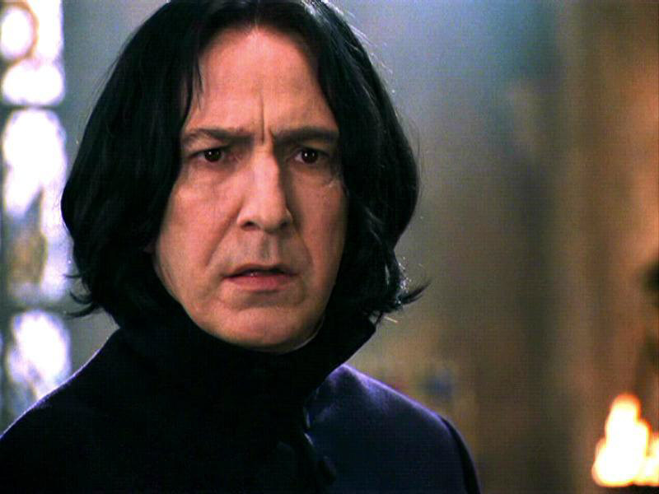
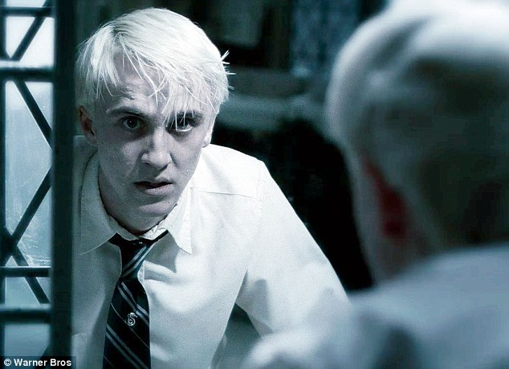
Dynamic or Static? Which is which?

Slide 12
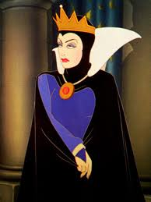
Stock Character
A one-dimensional character who is instantly recognizable to us from other stories.
Often are based on stereotypes.
Examples:
The bratty young sibling
The evil step-parent
The ditzy blond

