Slide 1
Allegory and Symbols

Slide 2
Symbol Definition
An object, person, place, thing or action that has a meaning in itself and also stands for something larger
It means something beyond what it is on a literal level

Slide 3
Symbols in Literature
Symbols allow writers to suggest layers of meanings and possibilities that a simple literal statement could not convey as well
Symbols function perfectly well in isolation from other symbols as long as the reader already knows their assigned meaning

Slide 4
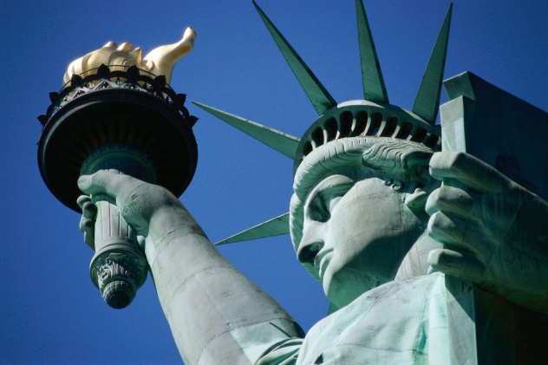
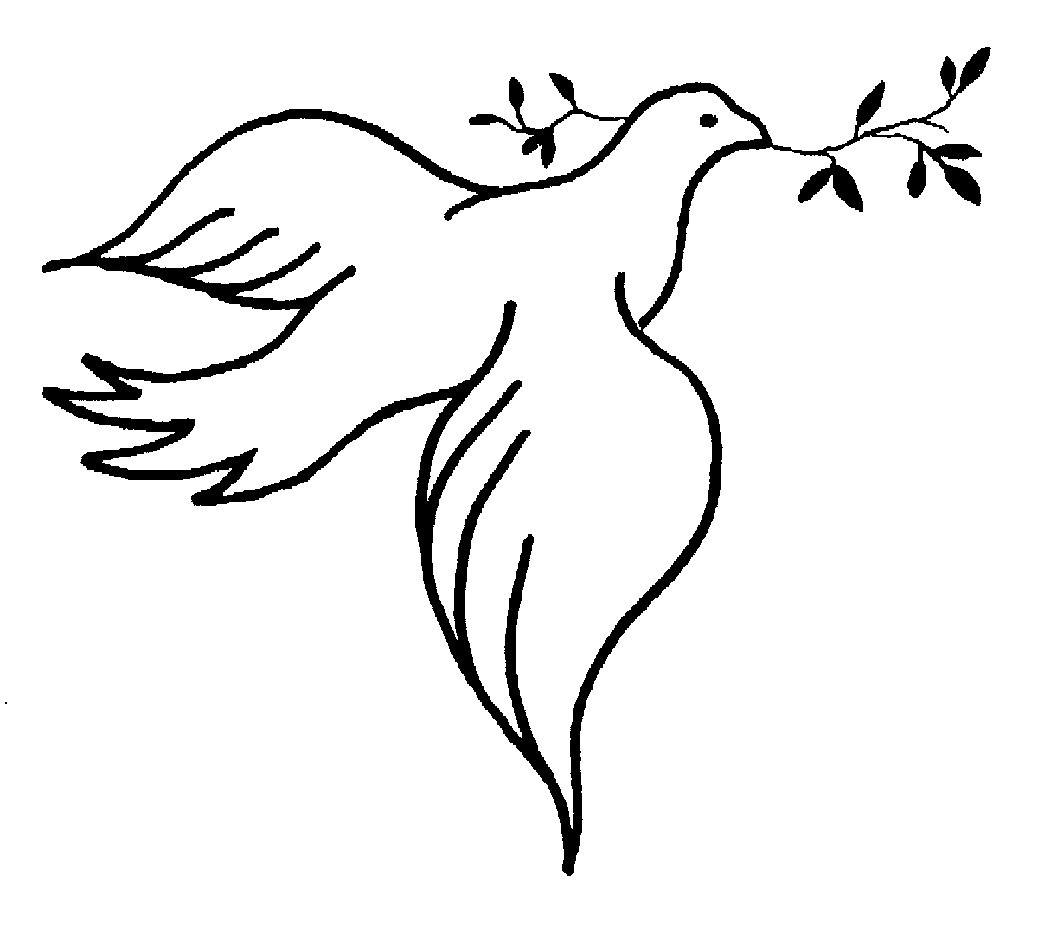
Symbol Examples

Slide 5
Symbols and Allegory
An allegory uses symbols, but is different than a symbol itself.
It is important you understand the difference.

Slide 6
Allegory Definition Simple
An allegory is a story with two meanings
one literal
one symbolic

Slide 7
Allegory Definition Complex
An allegory is a form of extended metaphor
Objects, persons, and actions in a narrative, are equated with the meanings that lie outside the narrative itself

Slide 8
Allegory and Symbols
An allegory involves using many interconnected symbols or allegorical figures so that nearly every element of the narrative has a meaning beyond the literal level

Slide 9
Types of Allegory
Political
Religious
Historical
Philosophical

Slide 10
Examples of Allegories
Animal Farm
The Chronicles of Narnia (debatable)
Life of Pi (debatable)
The Matrix (movie)
District 9 (movie)
Lord of the Flies
The Hunger Games
Avatar (movie)

Slide 11
The Matrix
A religious allegory
Neo = A saviour/messiah
Some debate on this – many religious symbols are included in the movies

Slide 12
Lord of the Flies
Can be read as a religious or political allegory
Basic allegory
The Island = the world
The island is a microcosm of the world

Slide 13
Interesting Fact
The word allegory derives from the Greek allegoria ("speaking otherwise")
The term loosely describes any story in verse or prose that has a double meaning

Slide 14
Symbolism vs. Allegory
A symbol can be a word, place, character or object that means something beyond what it is on a literal level.
An allegory involves using many interconnected symbols or allegorical figures in such a way that nearly every element of the narrative has a meaning beyond the literal level.

Slide 15
Allegory Extension –The Sneetches
What causes a group of people to feel superior or inferior to others?
http://www.youtube.com/watch?v=PdLPe7XjdKc

Slide 16
The Hunger Games and Allegory
Read the movie review “The Hunger Games: A modern allegory and a rare treat”

Slide 17
Homework
Listen to Yann Martel discuss why he uses allegory in his writing
Listen to his answers to the first two questions
http://bigthink.com/videos/what-allegories-can-teach-us

