Slide 1
A Formal Literary Paragraph

Slide 2
What is a formal literary paragraph?
A FLP is an analytical paragraph that makes and supports an argument.
You will be given a topic to discuss.
Your task is to create an idea based on the topic and to find relevant and supporting examples in the text to support your idea.

Slide 3
The FLP is the starting point
A FLP is written using similar techniques to an essay.
By practicing writing the FLP, you will also be establishing necessary essay writing skills.

Slide 4
Step 1 – The Hook
Write a catchy first sentence to interest your reader.
Make sure you connect it to your topic sentence.
Remember, there are lots of different ways to start your paragraph.

Slide 5
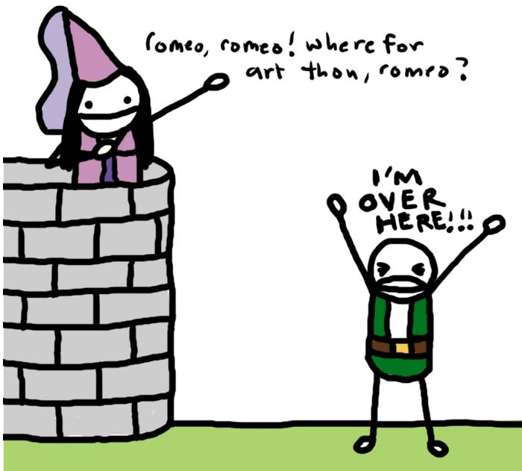
Step 2 – Topic Sentence
Your topic sentence must inform your reader of three things:
The author(s)
The title (s)
Your main idea

Slide 6
Examples
In William Golding’s The Lord of the Flies, Ralph is very athletic and charismatic protagonist.
Author
Title
Main Idea

Slide 7
Examples
In “Talk and Text, Crash and Die”, Jeremy Cato uses various persuasive techniques to encourage the reader to use their cell phone responsibly.
Title
Author
Main Idea

Slide 8
Important Note
When referring to titles of books, plays, poems, and articles there are rules you must follow:
1) Underline or italicize titles of novels and plays
The Lord of the Flies or The Hunger Games
2) Use quotation marks for poems, short stories, and articles
“The Wasteland”
“Talk and Text, Crash and Die”

Slide 9
Step 3 – Make your 3 points
You want to include a minimum of three points in your paragraph.
The best way to present your points is to use the ACE structure.
You will need to use the ACE structure three times.

Slide 10
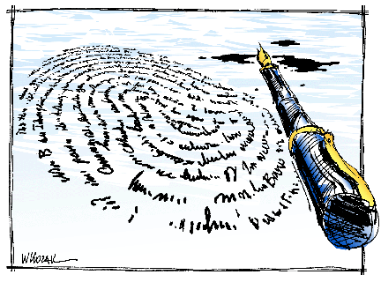
ACE Your Writing
Assertion (your point)
Citation (a quote or paraphrase)
Explanation (explains how your citation supports your assertion)

Slide 11
Example
Assertion: Cato uses statistics to appeal to the reader’s logic.
Citation: For instance, he states that the “National Highway Traffic Safety Administration figures ‘distraction-affected crashes’ kill at least 3,000 people a year,” demonstrating that people should stop texting while driving (Cato 1).
Explanation: By using a staggering statistic Cato hopes that people’s common sense will prevail.

Slide 12
The Quote Sandwich
Don’t forget the quote sandwich.
Remember that you always need to introduce your quote.
For instance, he states that the “National Highway Traffic Safety Administration figures ‘distraction-affected crashes’ kill at least 3,000 people a year,” demonstrating that people should stop texting while driving (Cato 1).

Slide 13
Step 4 – A thoughtful conclusion
A strong concluding statement is extremely important.
You want to restate your main idea in a new and thought provoking way!

Slide 14
FLP Structure
Hook
Topic Sentence
ACE # 1
Assertion
Citation
Explanation
ACE #2
ACE # 3
Concluding Sentence

Slide 15
Formal Writing Rules
Avoid summarizing. You should assume your reader is very familiar with the text.
Always use the present tense.
Ex. Romeo was in love with Juliet.
This means Romeo is no longer in love with Juliet.
Ex. Romeo is in love with Juliet.

Slide 16
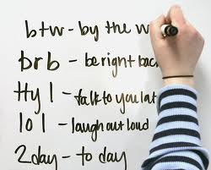
Formal Writing Rules
Use formal language.
No contractions
Don’t, can’t, doesn’t
Use the third person.
Do not use “I think..”
Avoid colloquial language
“Like, Juliet, is like, so, totally cool.”

Slide 17
Formal Writing Rules
Use transition words to connect your ideas

Slide 18
Transition Words/Phrases
Example #1:
To be honest, you must tell the truth. If you cheat on a test, that’s being dishonest. It’s better to receive the mark you deserve and learn from your mistakes. Tell the truth; it’s worth it!
Example #2:
In order to be honest, you must tell the truth. For example, if you cheat on a test, that’s being dishonest. Therefore, it’s better to receive the mark you deserve and learn from your mistakes. Tell the truth; it’s worth it!

